Slide 1
Cognitive Service Integrate with Power BI
Egg Cheng
v-egche@microsoft.com

Slide 2
Download Slides
https://aka.ms/fpg_workshop

Slide 3

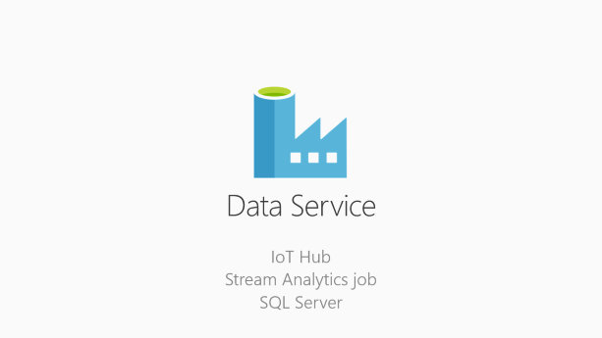
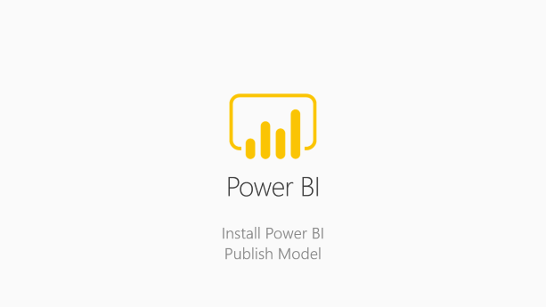

Integration
Cognitive Service
business intelligence

Slide 4

Cognitive Service
Face API
Emotion API

Slide 5
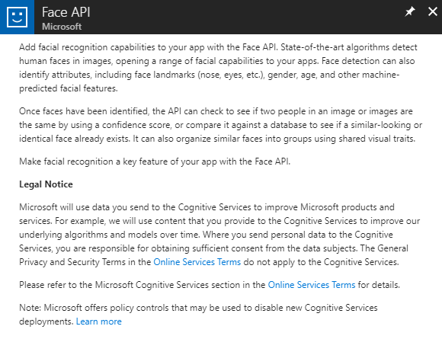
Create Face API
Once faces have been identified, the API can check to see if two people in an image or images are the same by using a confidence score

Slide 6
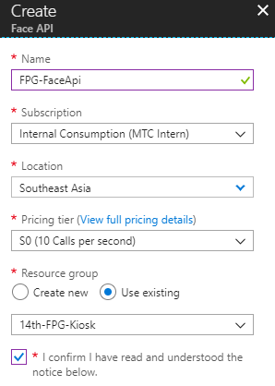
Create Face API
Configure Settings
Configure Settings

Slide 7
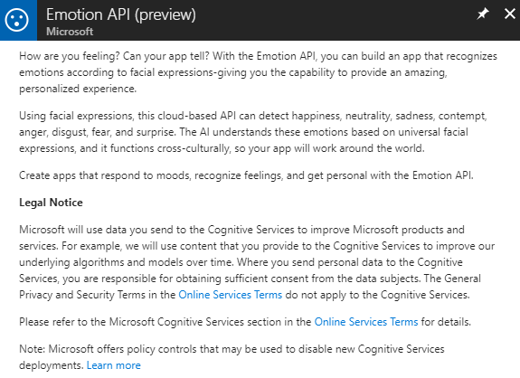
Create Emotion API
Using facial expressions, this cloud-based API can detect happiness, neutrality, sadness, contempt, anger, disgust, fear, and surprise.

Slide 8
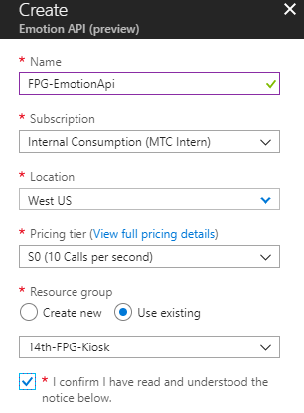
Create Emotion API
Configure Settings

Slide 9

Data Service
IoT Hub
Stream Analytics job
SQL Server

Slide 10
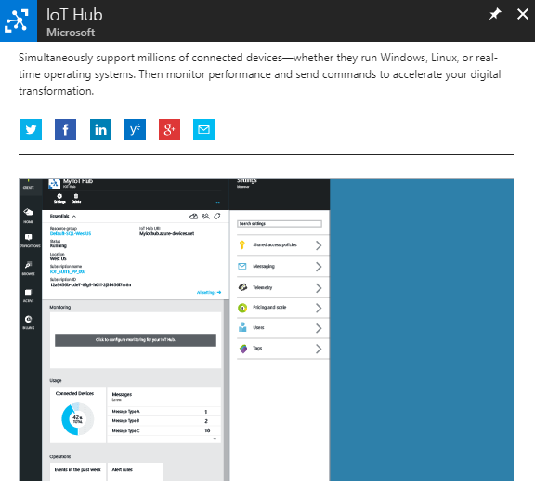
Create IoT Hub
Provides multiple device-to-cloud and cloud-to-device communication options. These options include one-way messaging, file transfer, and request-reply methods.

Slide 11
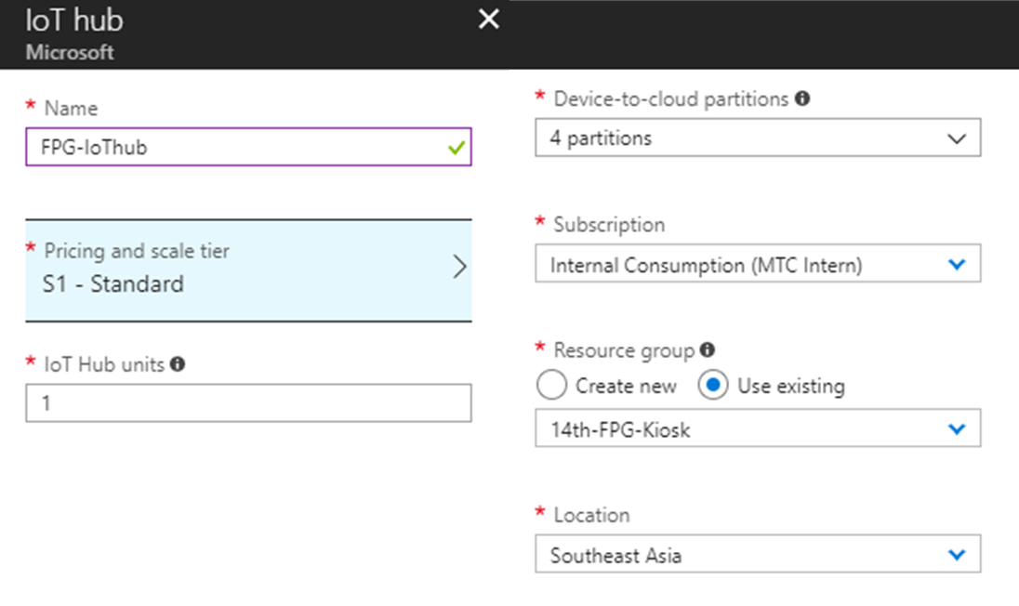
Configure IoT Hub Settings
Configure Settings

Slide 12
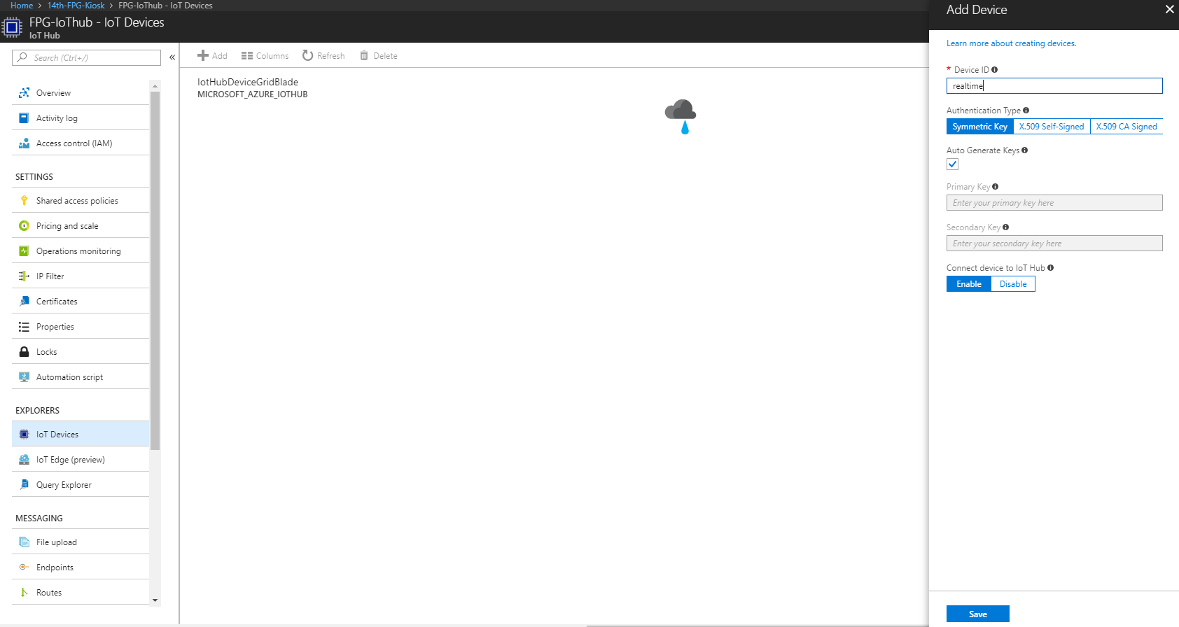
IoT Device
Add a new

Slide 13
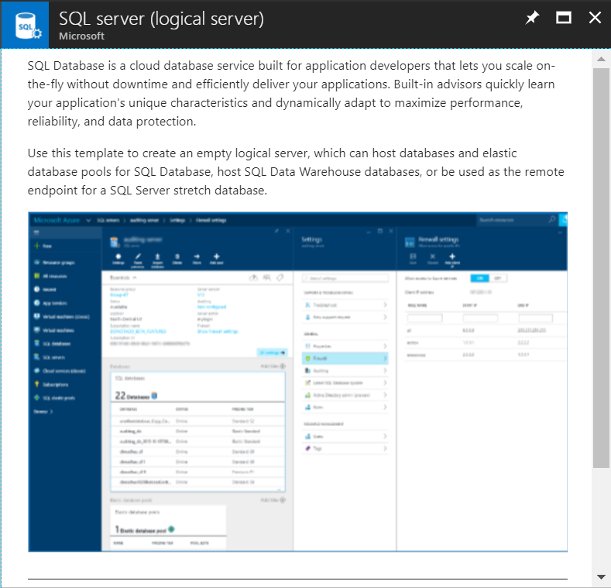
Create SQL Server
SQL Database is a cloud database service built for application developers that lets you scale on-the-fly without downtime and efficiently deliver your applications.

Slide 14
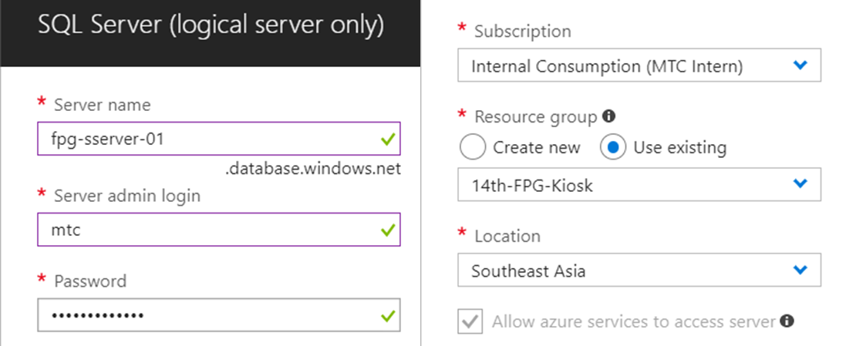
Setting SQL Server Account
Setting admin account & Southeast Asia location

Slide 15
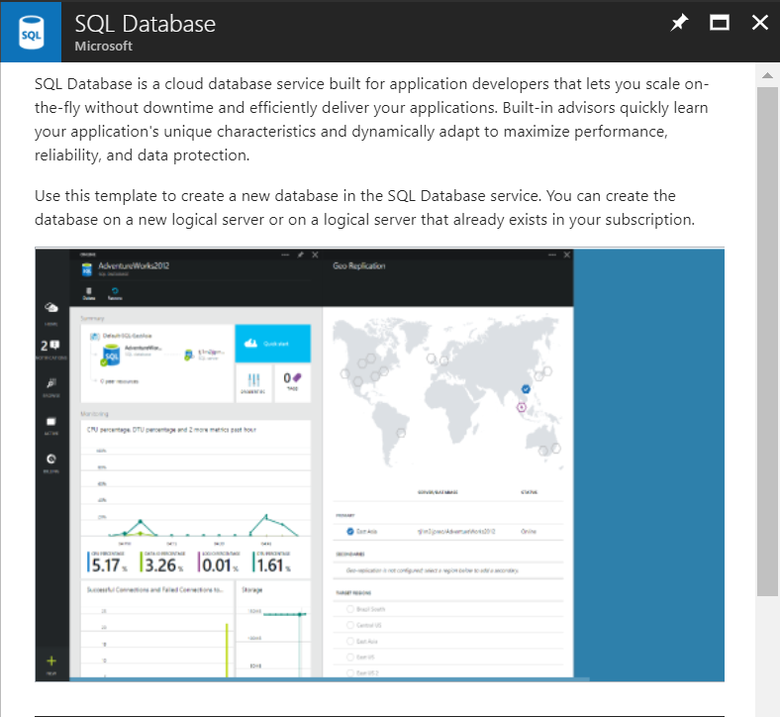
Create SQL Database
SQL Database is a cloud database service built for application developers that lets you scale on-the-fly without downtime and efficiently deliver your applications.

Slide 16
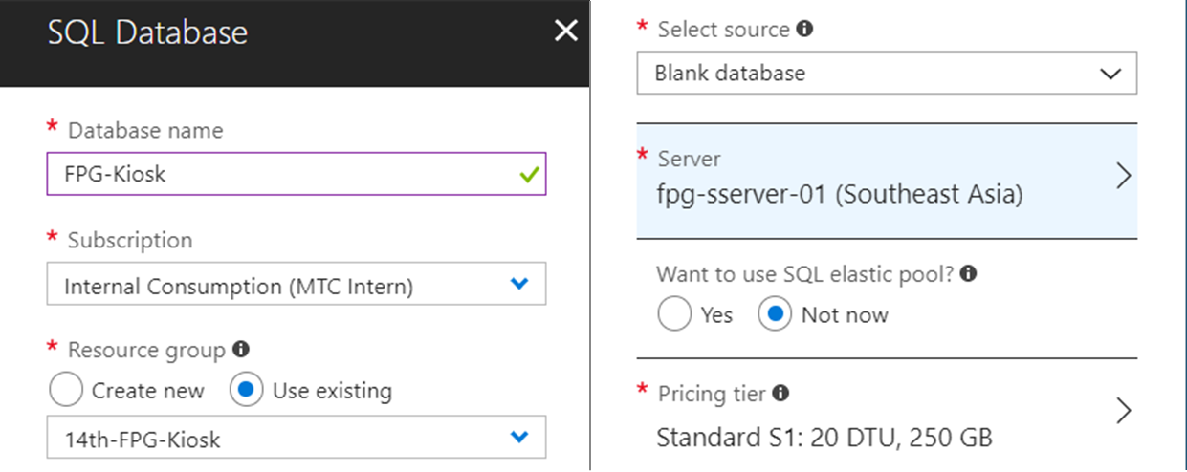
Create SQL Database
Setting server

Slide 17
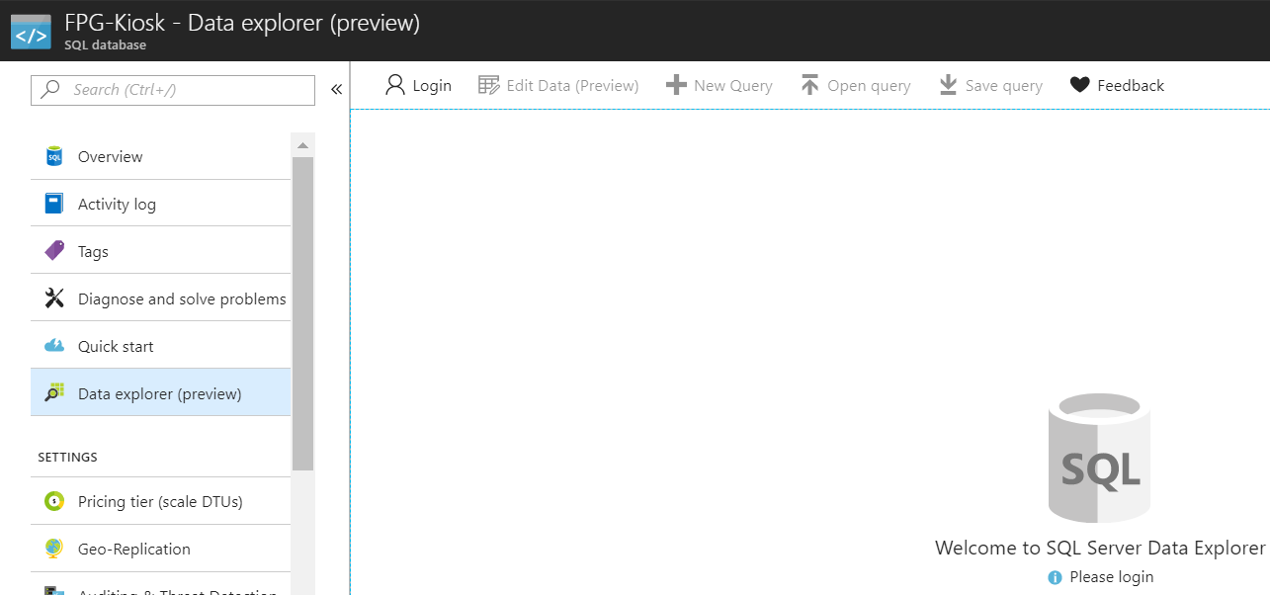
Login into SQL Server

Slide 18
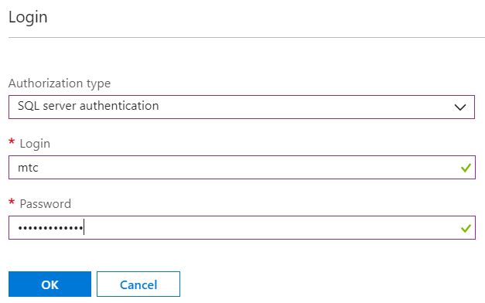
Login into SQL Server

Slide 19
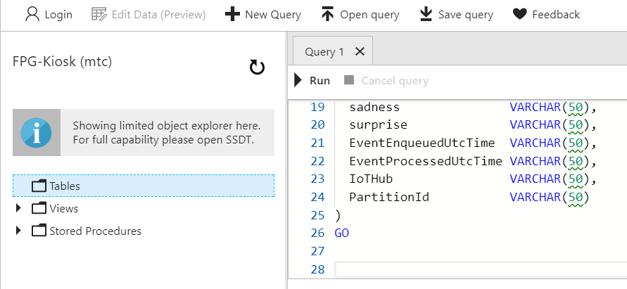
Paste SQL Code
Using the code which in the following link
https://aka.ms/IntelKiosk_SQL

Slide 20
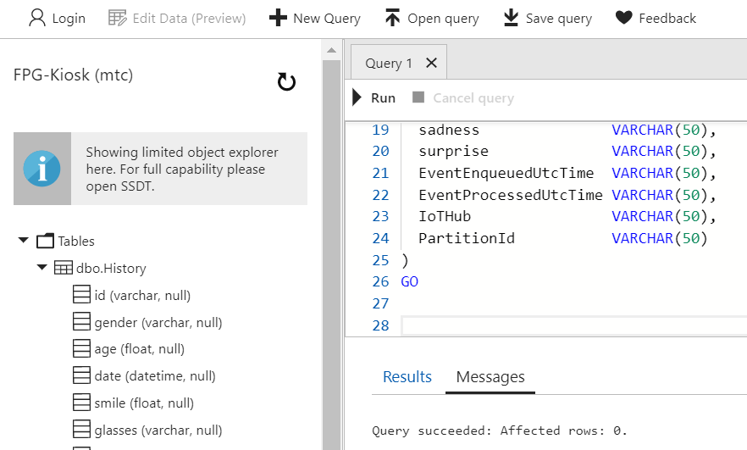
Reload & Check

Slide 21
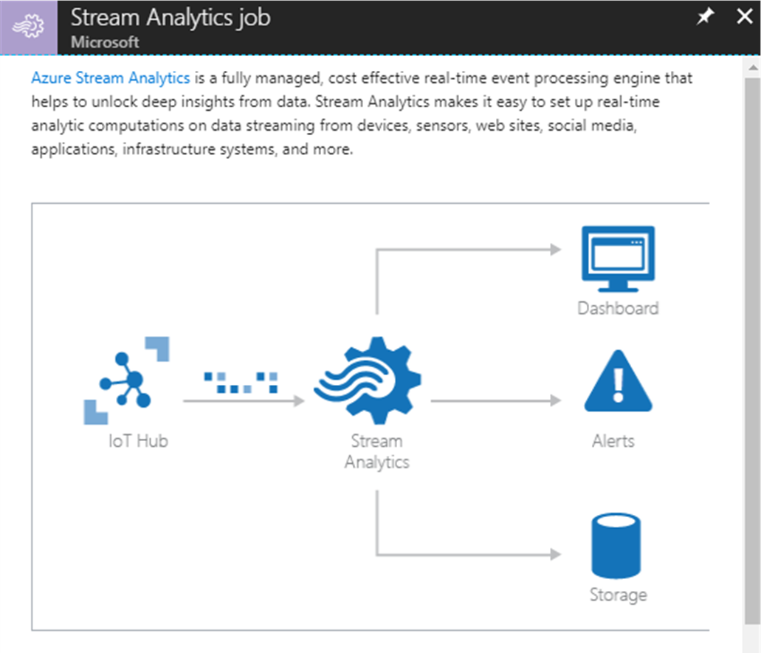
Create Stream Analytics Job
Azure Stream Analytics is a fully managed, cost effective real-time event processing engine that helps to unlock deep insights from data

Slide 22
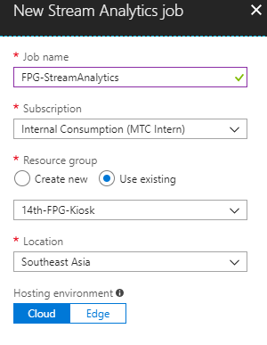
Configure Stream Analytics Job

Slide 23
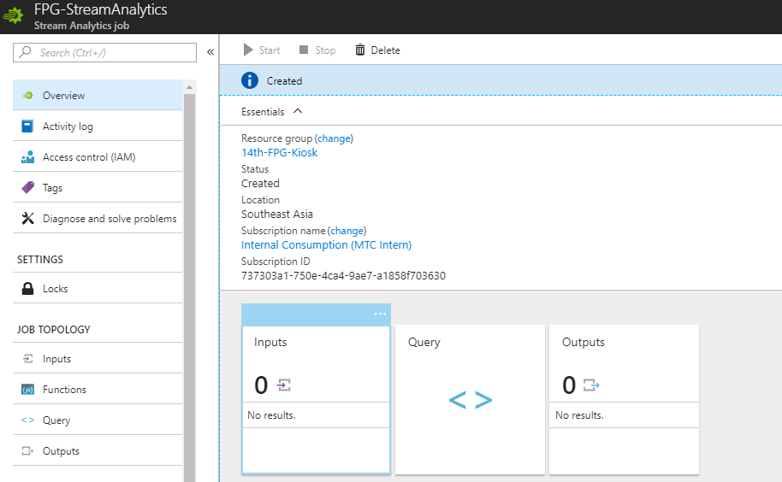
Setting Stream Analytics Job Inputs

Slide 24
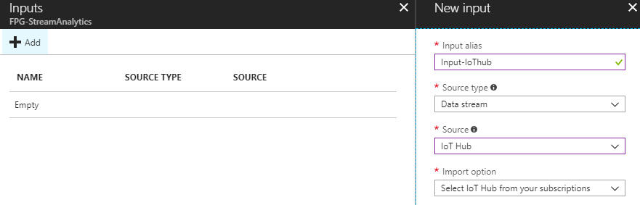
Add a new input from IoT Hub

Slide 25
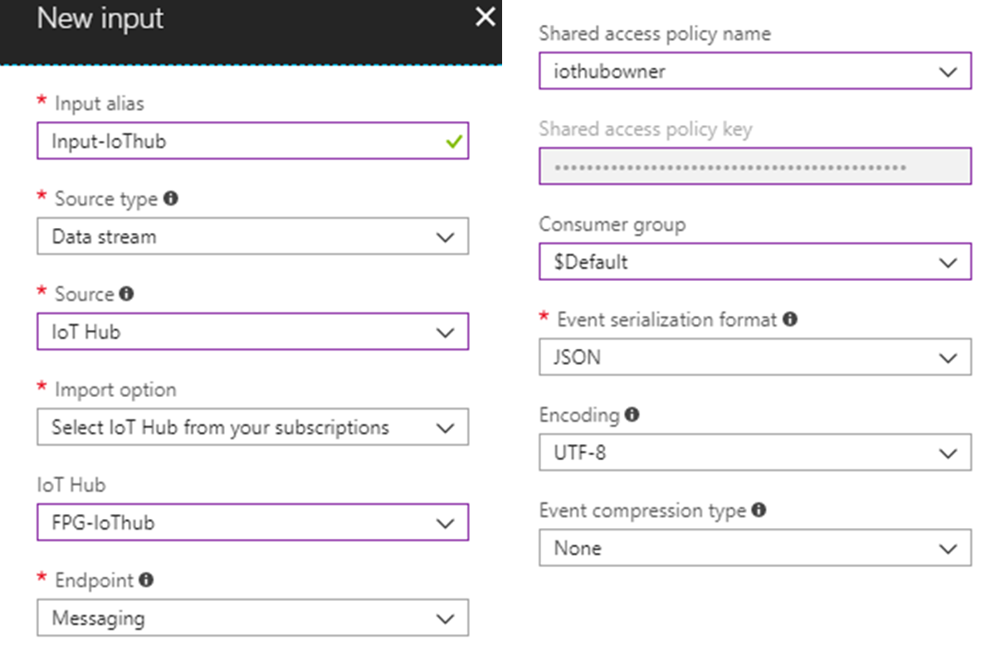
Setting Input Source

Slide 26
Setting Stream Analytics Job Outputs

Slide 27
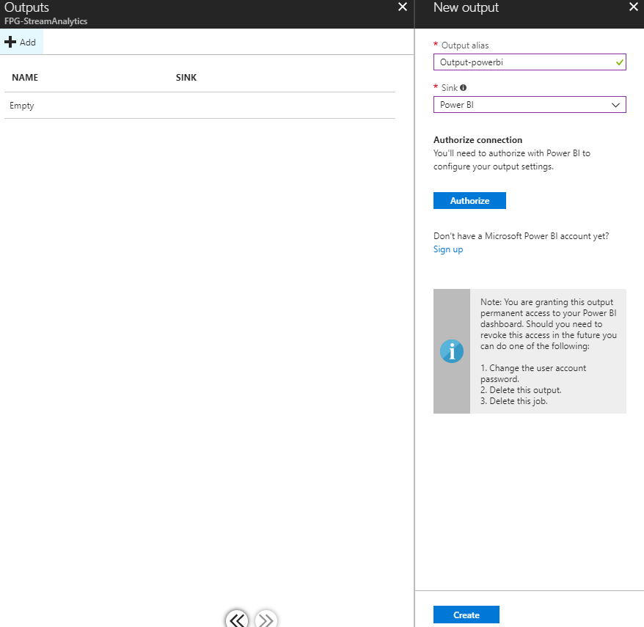
Create Stream Analytics Job
Configure Settings

Slide 28
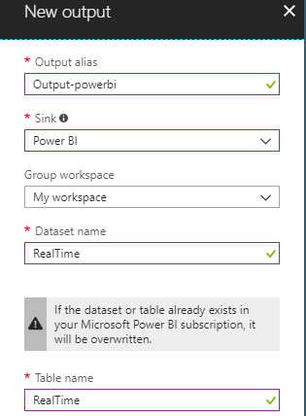
Setting Output to Power BI

Slide 29
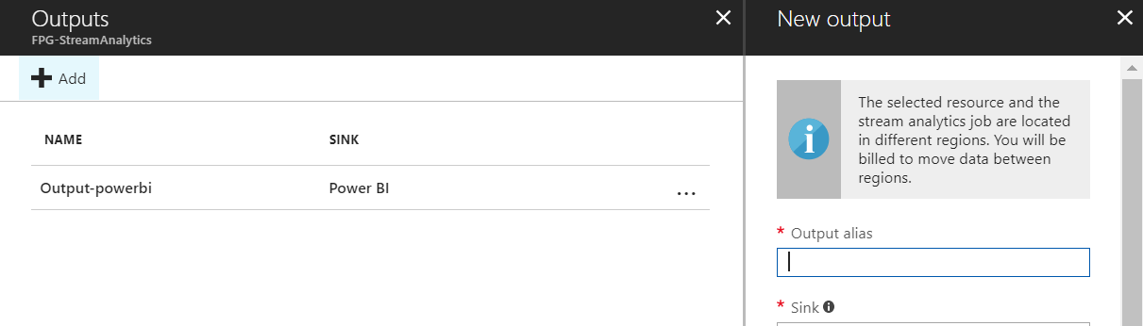
Add a new output to SQL Server

Slide 30
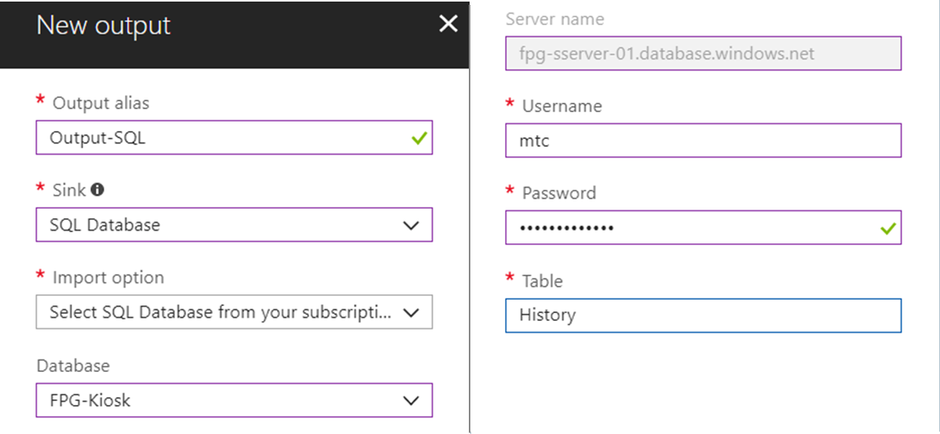
Setting Output to SQL Server

Slide 31
Setting Stream Analytics Job Query

Slide 32
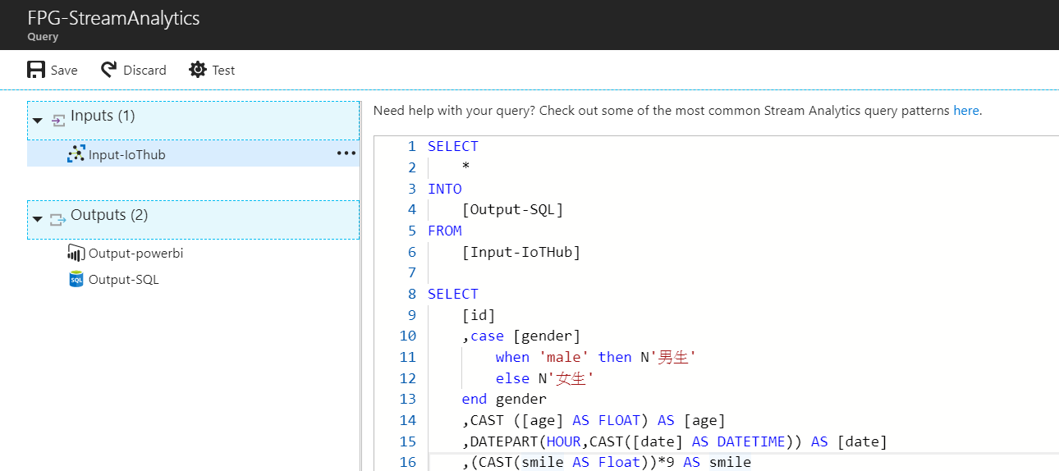
Setting Query
https://aka.ms/IntelKiosk_SA

Slide 33
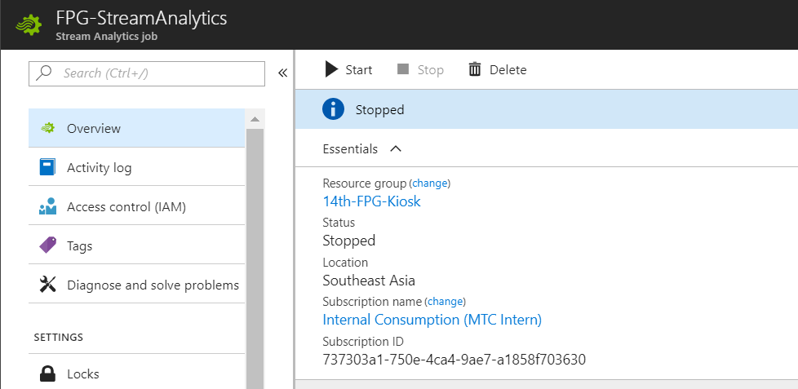
Enable Stream Analytics Job

Slide 34

Download Intelligent Kiosk Sample
https://aka.ms/IntelKioskSample

Slide 35
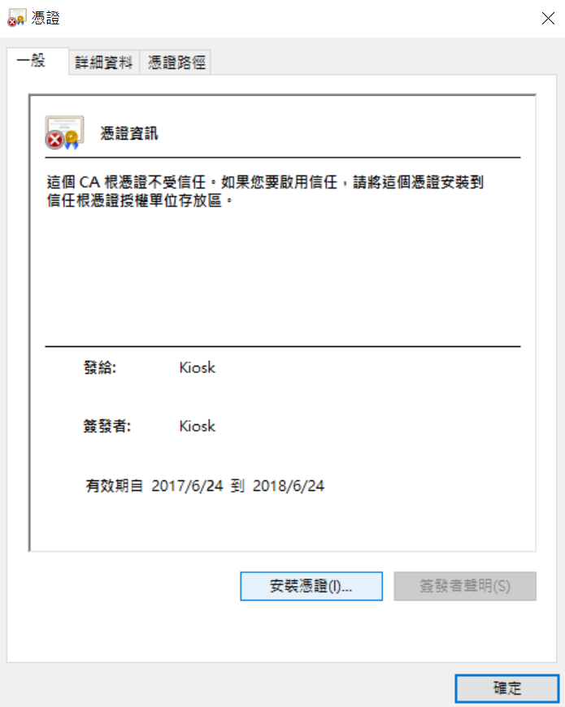
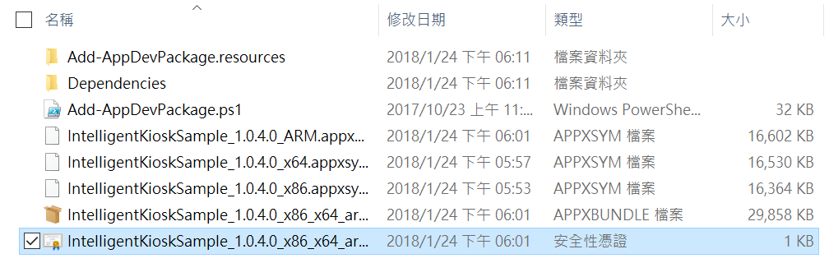
Install Certificate

Slide 36
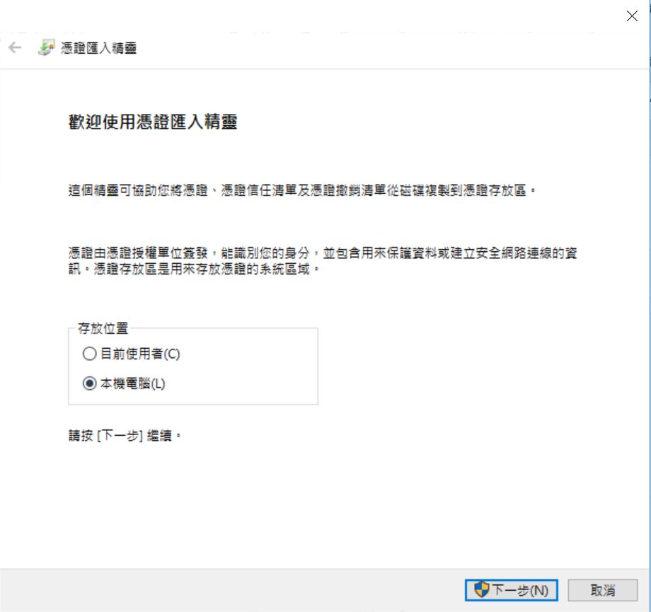
Select Local Machine

Slide 37
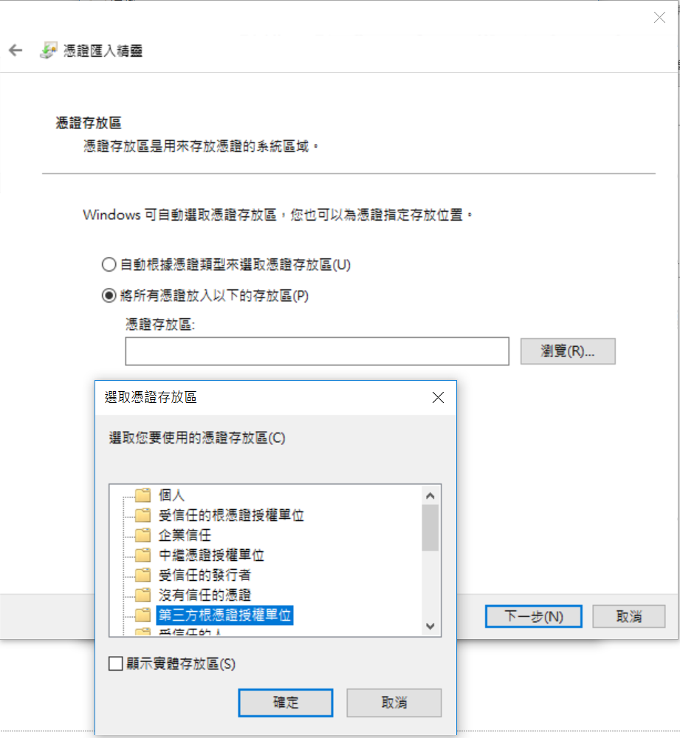
Select Third-Party Root Certification

Slide 38
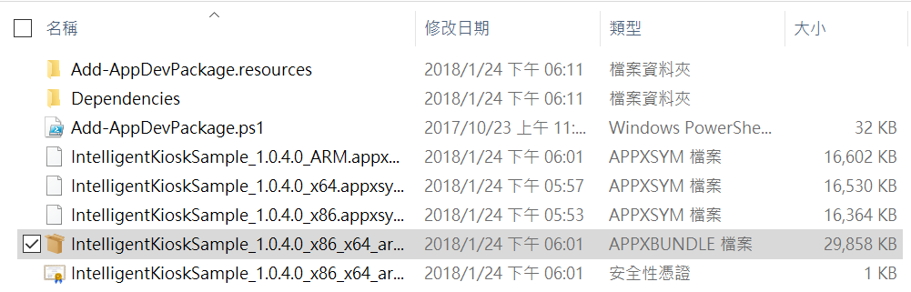
Select Third-Party Root Certification

Slide 39
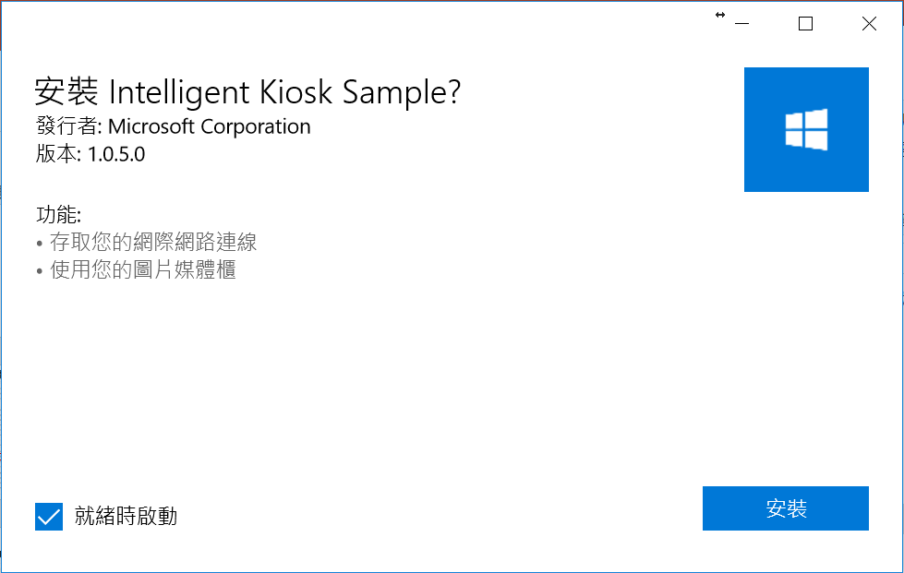
Install Intelligent Kiosk Sample

Slide 40
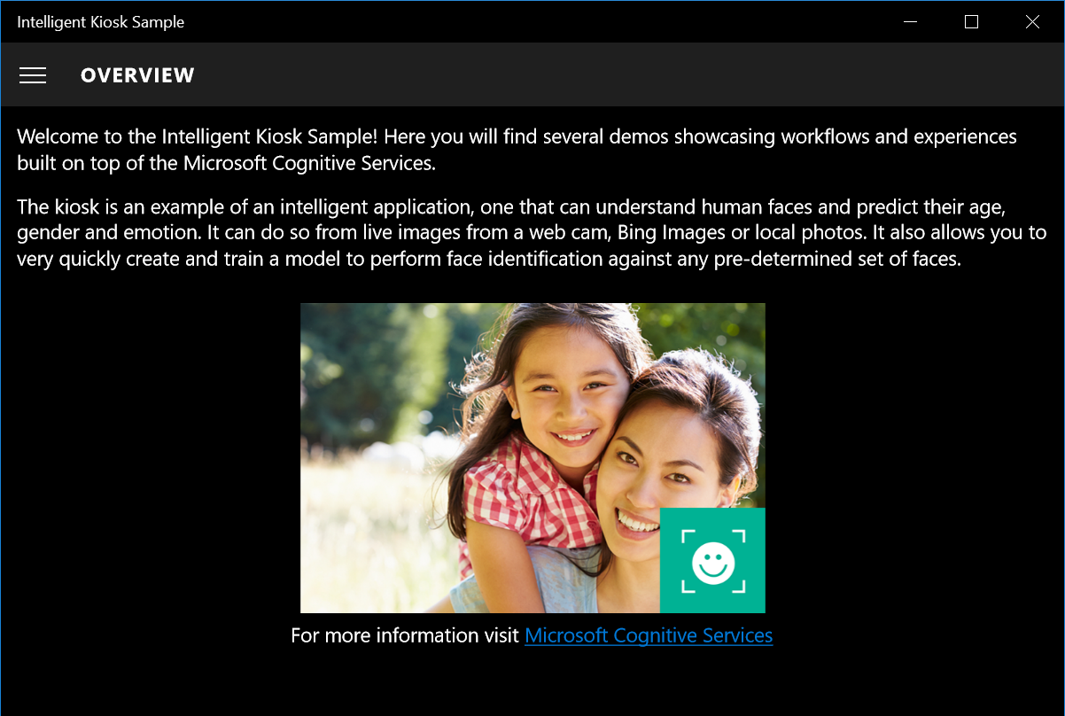
Launch Intelligent Kiosk Sample

Slide 41
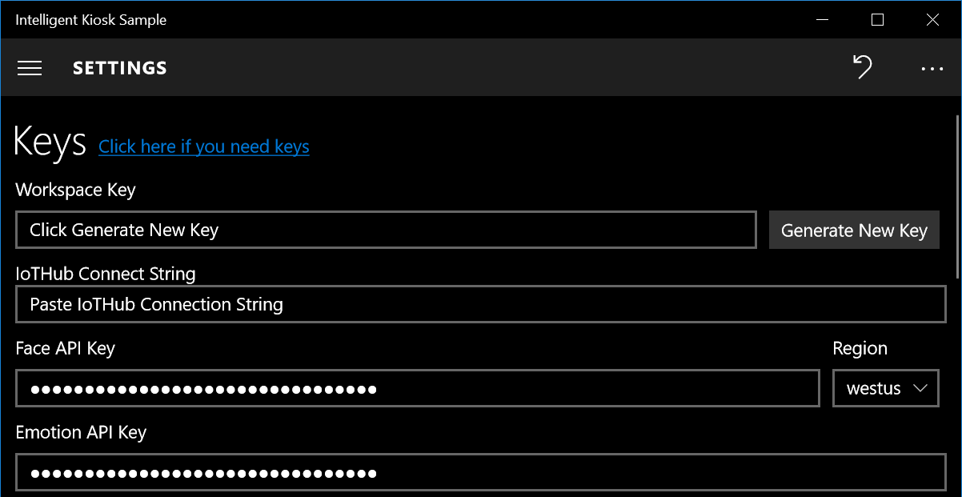
Setting API Keys

Slide 42
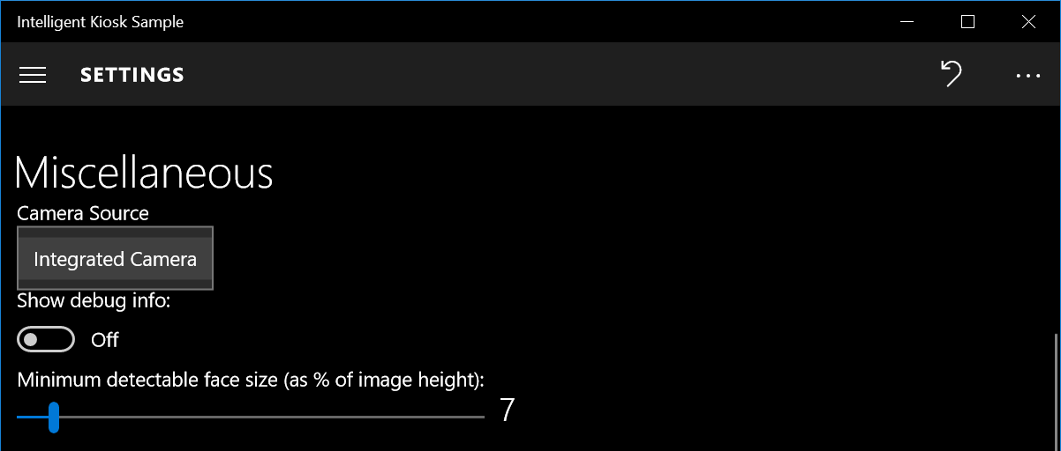
Setting Camera

Slide 43
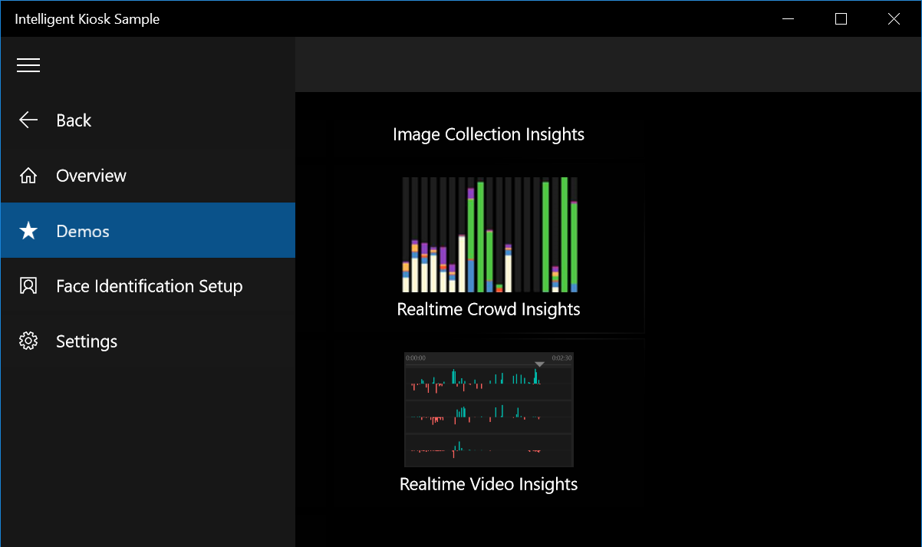
Launch Demo

Slide 44
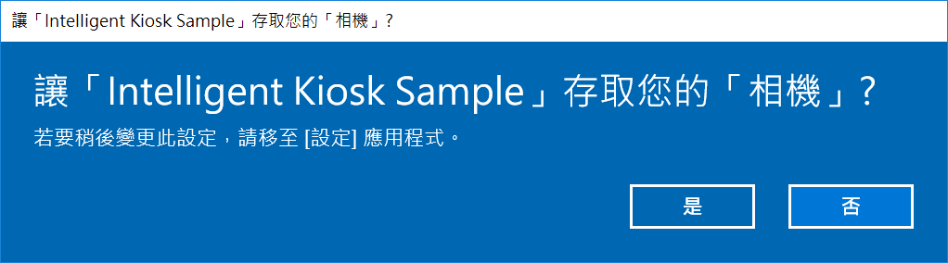
Allow Permission

Slide 45
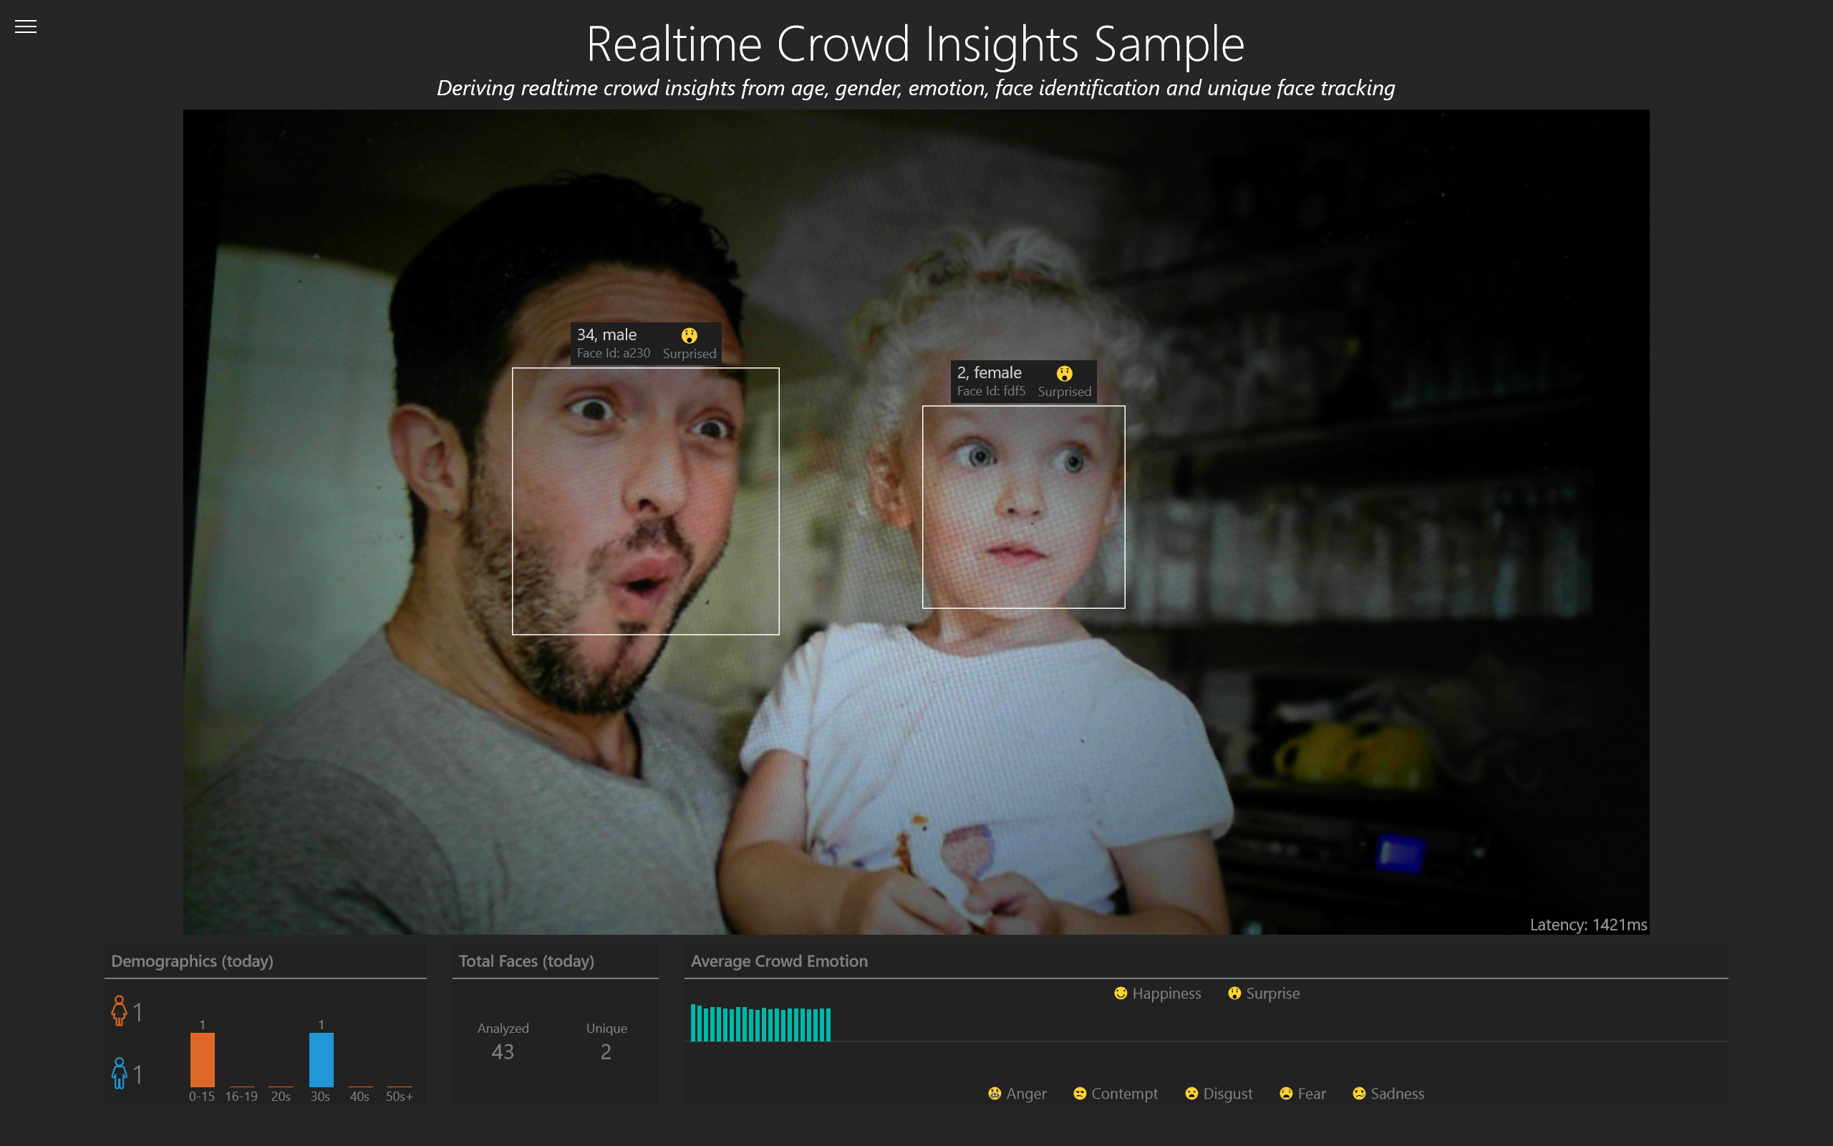
Demo

Slide 46

Power BI
Install Power BI
Publish Model

Slide 47

Download Power BI Desktop Document
https://aka.ms/IntelKiosk_BI

Slide 48
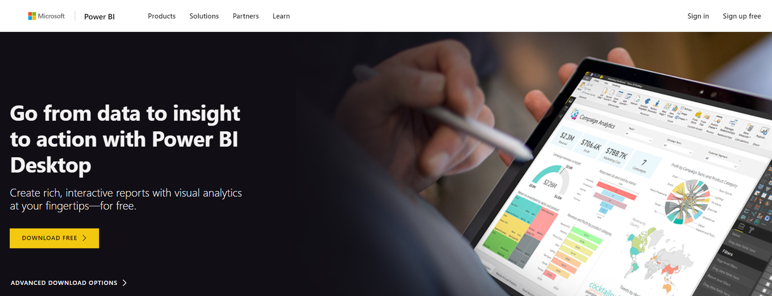
Download Power BI Desktop
https://aka.ms/download_powerbi

Slide 49
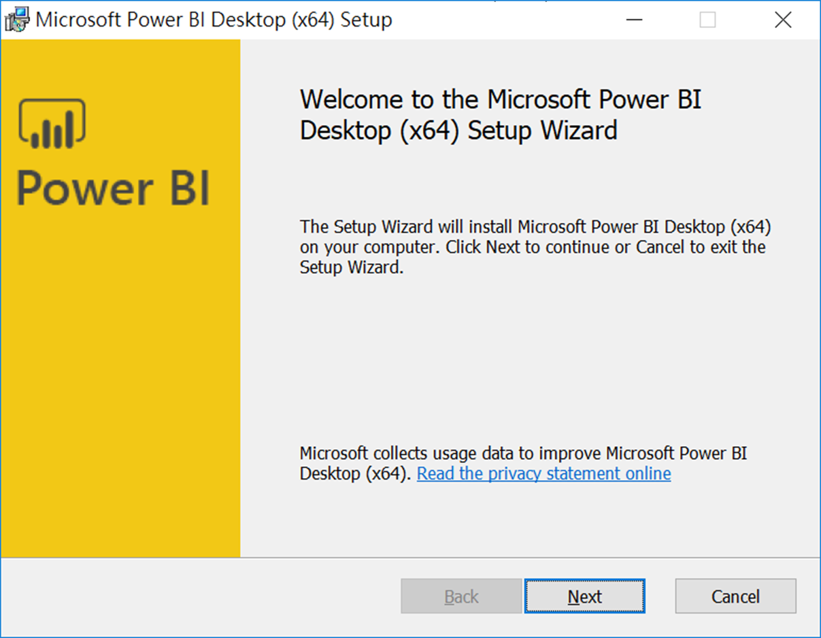
Install Power BI Desktop

Slide 50
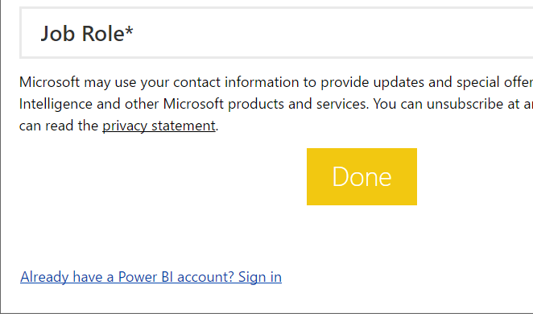
Click Sign In Link

Slide 51
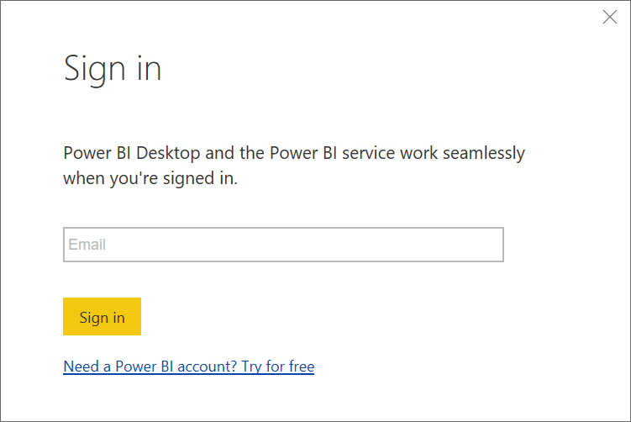
Login into Power BI

Slide 52
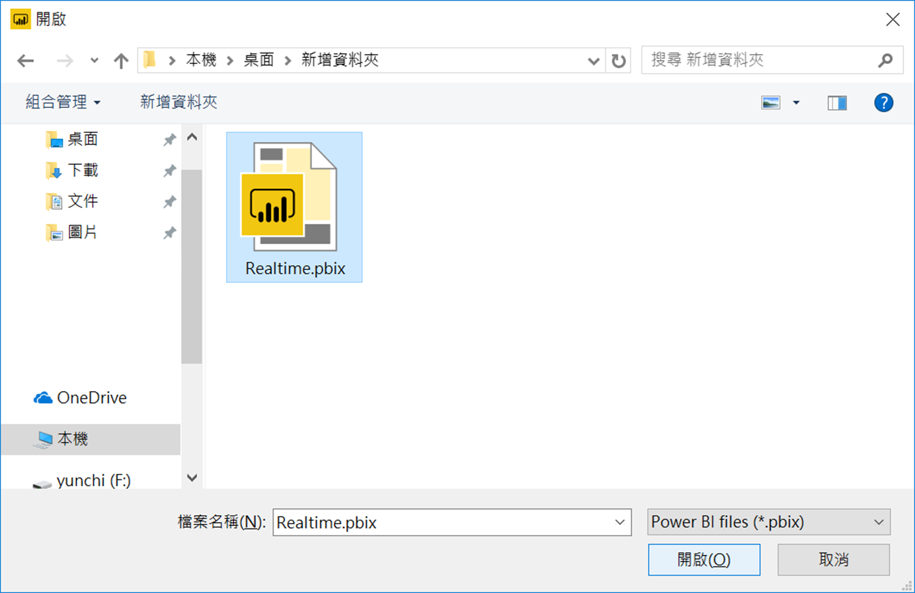
Open Realtime File

Slide 53
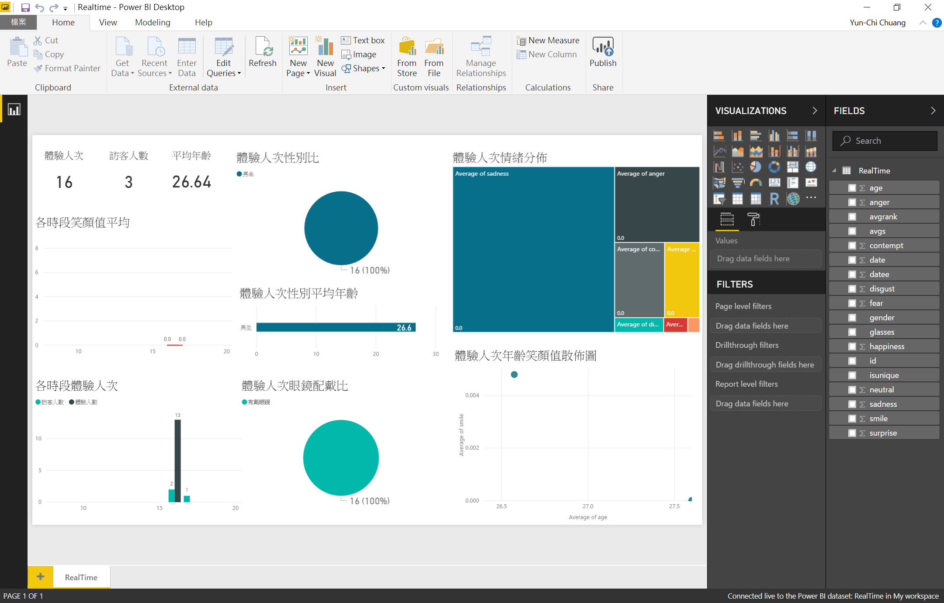
Power BI

Slide 54
Publish Model

Slide 55
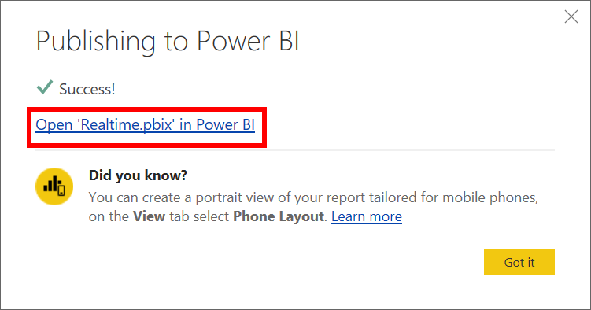
Create Stream Analytics Job
Configure Settings

Slide 56
Source Code
https://aka.ms/IntelKiosk_src

